Slide 1



DEVELOPING APPLICATIONS TO HELP INDIVIDUALS AND ORGANIZATIONS TRACK AND REDUCE THEIR CARBON FOOTPRINT
MICROSOFT TECHGIG 2023- GREEN SOFTWARE DEVELOPMENT

Slide 2

OUR TEAM
SATWIK REDDY KATUKURI
s a t w i k .v n r @.g.m.a. i. l . c o m

Slide 3

PROBLEM STATEMENT
The technology industry has a significant impact on the environment, with software development being one of the biggest contributors. The growing demand for technology has led to an increase in energy consumption and carbon emissions, which have adverse effects on the environment. Green software is a new approach to software development that aims to reduce the environmental impact of technology.
The challenge is to build intelligent tools and frameworks that will guide and enable developers and the larger tech community to design and build green code. These tools and frameworks should be intuitive and provide developers with recommendations and best practices to reduce carbon footprint spanning the entire software development life cycle (SDLC).

Slide 4


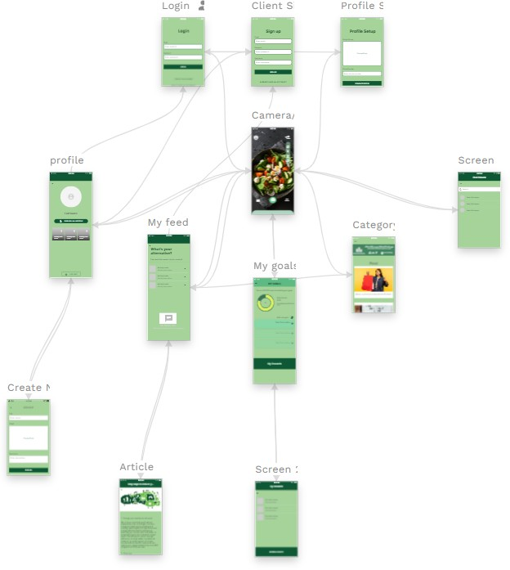
PROJECT DESIGN MAP
USING ADALO

Slide 5
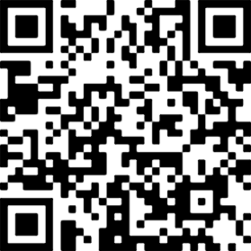
Go EcoSnap!
GO GR E E N !
Scan to use our app

Slide 6

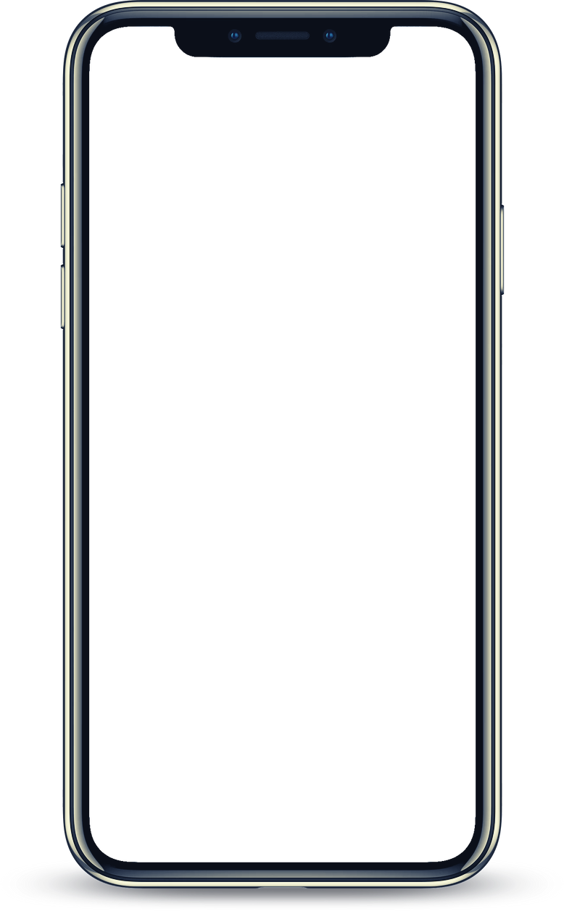
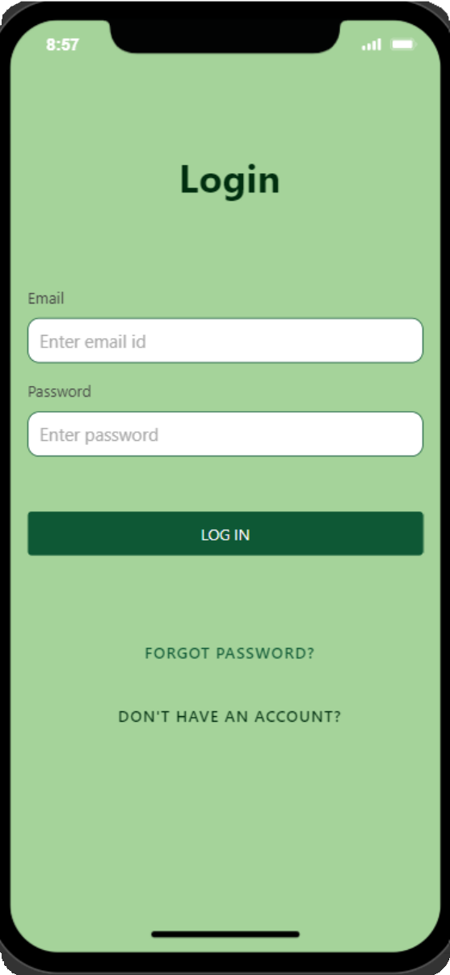
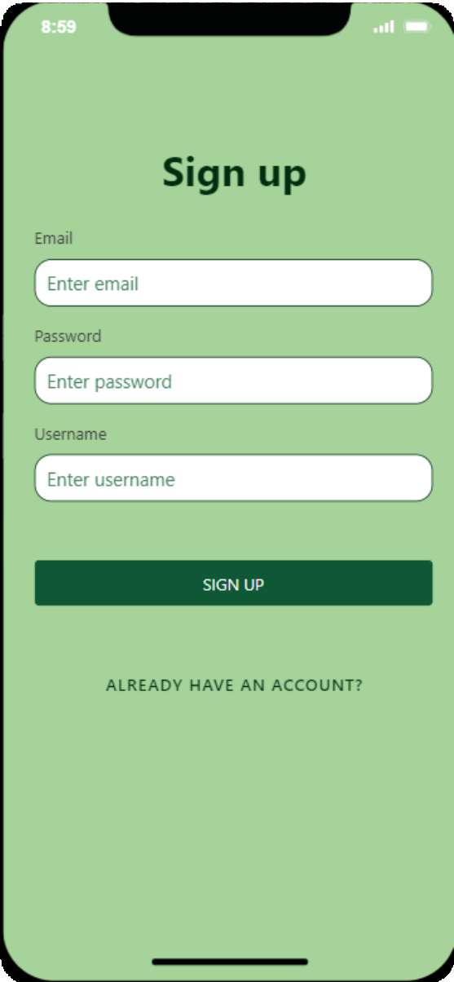
OUR INNOVATIVE SOLUTION

Slide 7

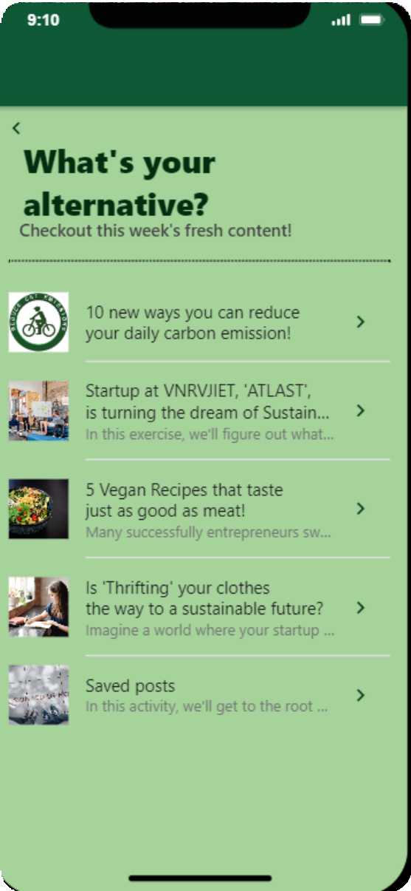

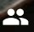
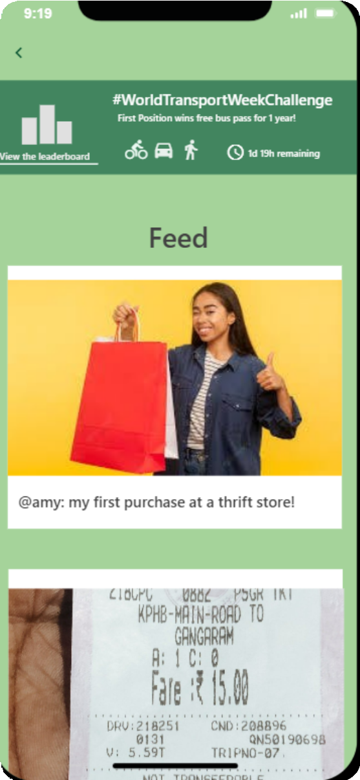
OUR INNOVATIVE SOLUTION

Slide 8

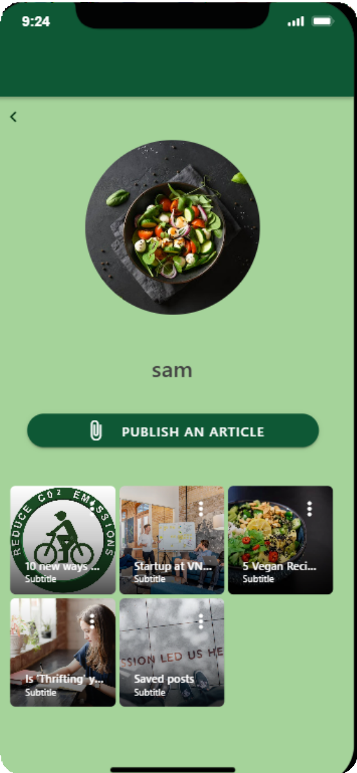
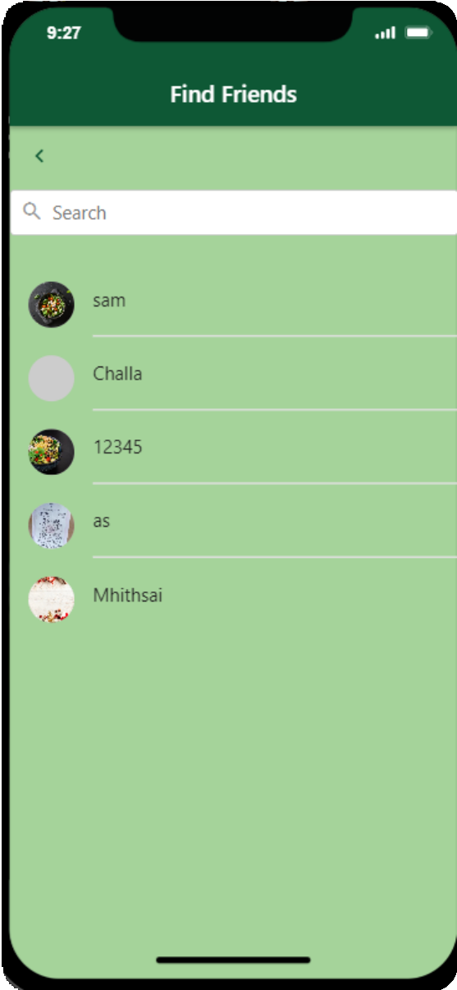


OUR INNOVATIVE SOLUTION

Slide 9
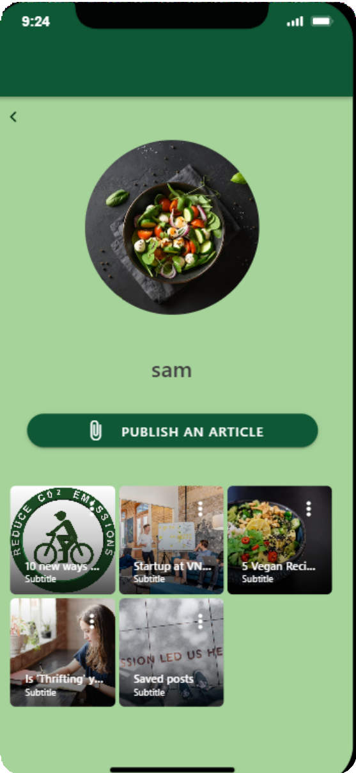

OUR INNOVATIVE SOLUTION

Slide 10
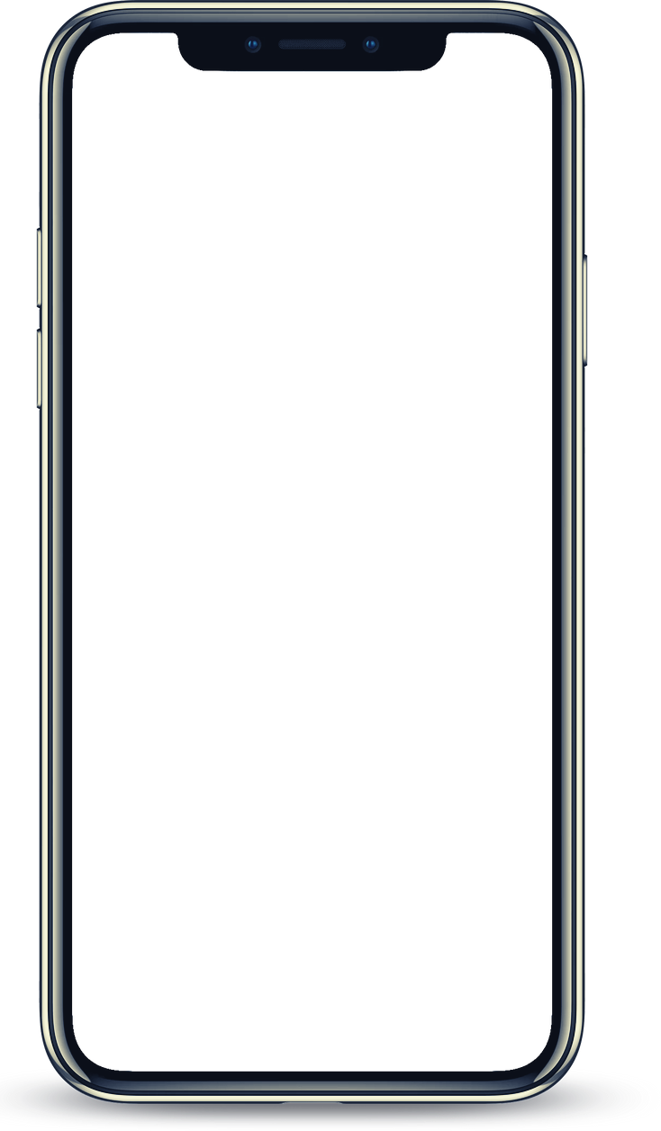
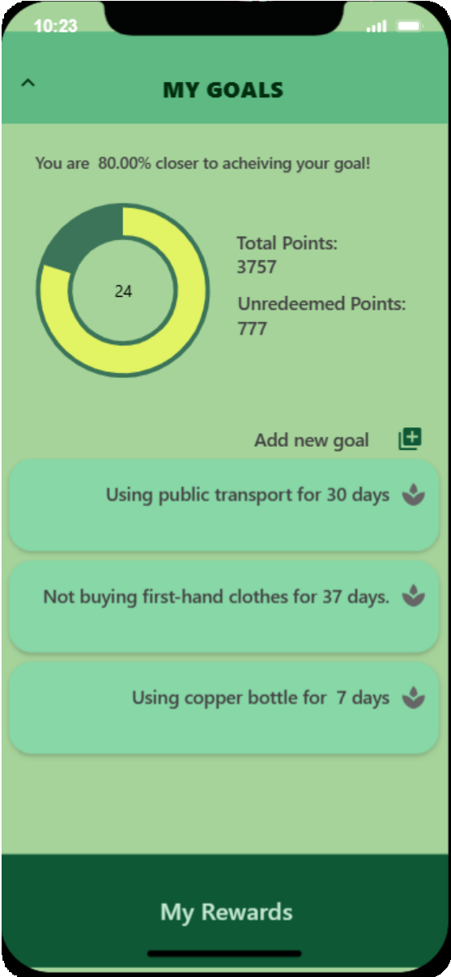
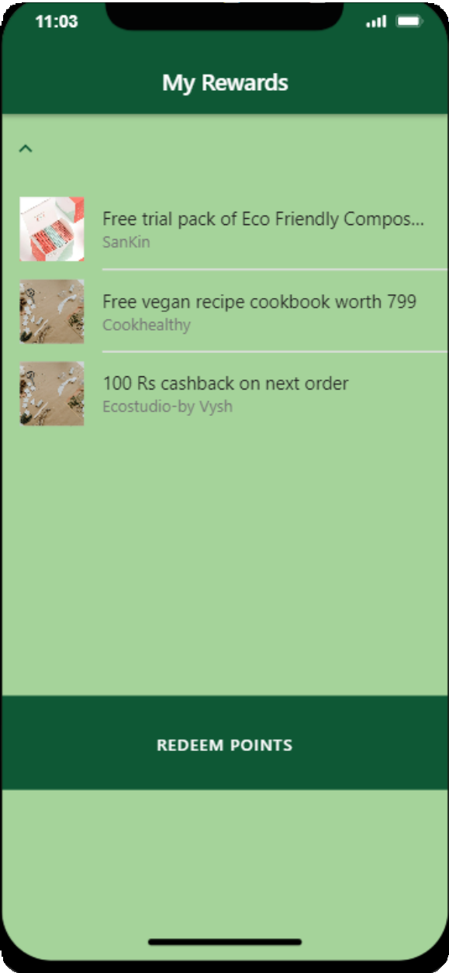
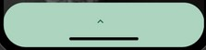

OUR INNOVATIVE SOLUTION

Slide 11

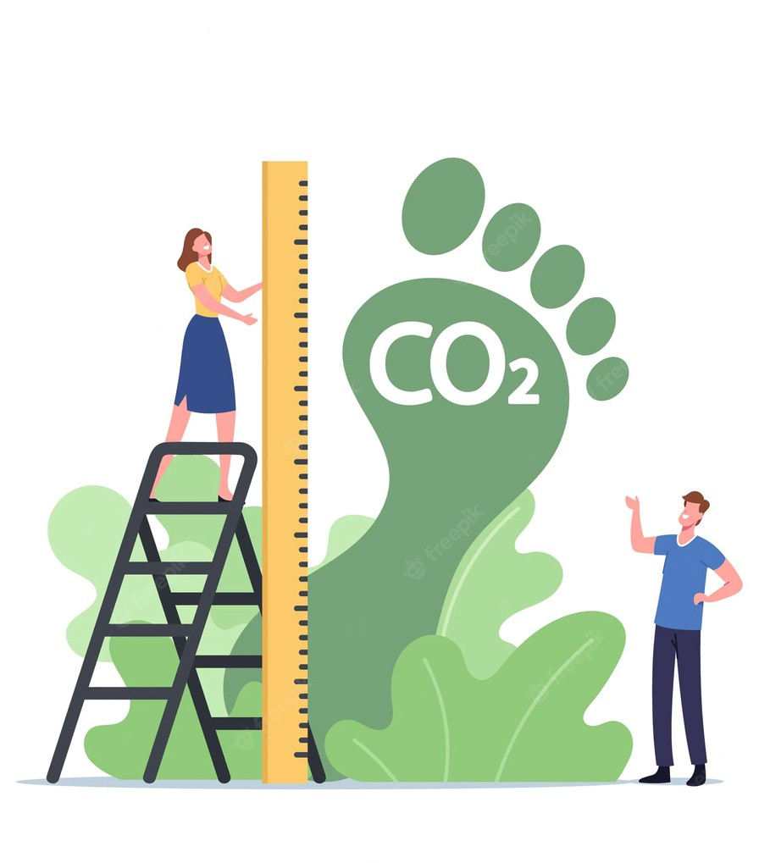
FUTURE SCOPE
Making advancements to the scope of the application is essential to keep up with the changing consumer habits, and evolving technologies. Some of our ideas for the future are:
Creating an Online Thrift platform for each city, where users from the city can buy pre-used clothes that are in good condition from each other, and collect it from a pickup location, which avoids the concept of sending via mail, hence reducing the carbon footprint.
Create a connectivity between students of the same college, where they can connect with people to carpool and save fuel, create less harm.
On a corporate social responsibility perspective, for a high level badge earned by the user, a sapling could be planted for them, or monetary contribution towards endangered species could be done, as a token of appreciation.

Slide 12

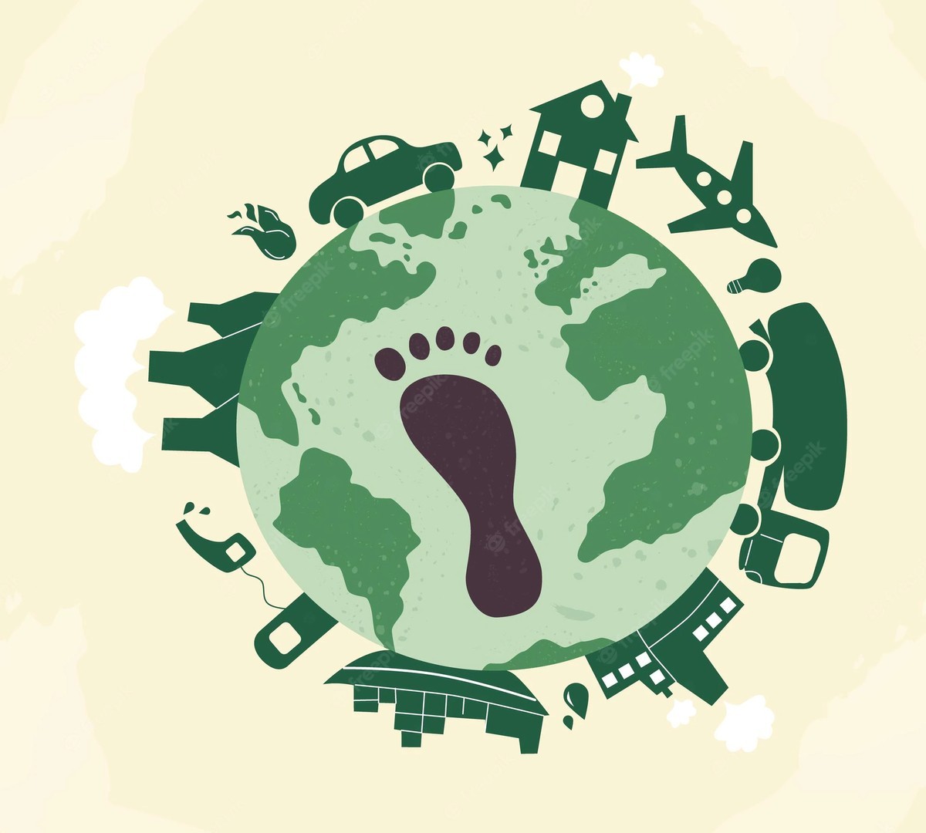
CONCLUSION
The purpose of developing this application is to create an interesting yet informative app where the impact is not just on the user, but also positively affects their surrounding environment too. The app is quick, easy to use, and at the same time, it's extensive features provide wide functionality to the users. Just like how people share updates about their life on social media, they do it here too, but for a good environmental cause.

Slide 13

THANK YOU

